Slide 1
Car Rental System
Ankur Muley

Slide 2
Why this Project
My Interest & Passion in Cars
Easy System to rent a Car
Faced a lot of problems while finding a car
User Friendly

Slide 3
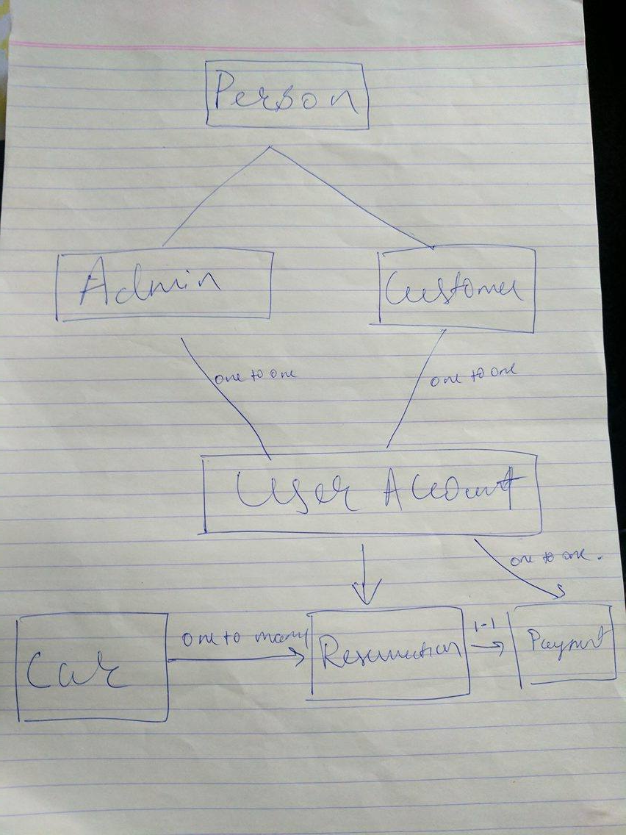
Object Model

Slide 4
Implemented
Spring
MVC
Hibernate
JSP
BootStrap
Annotation Mappings

Slide 5
THANK YOU

